Slide 1
3D Analog Clock –Maya 2026 Project
Krishna M Singh 24CS2024 Integrated Dual Degree(IDD) Computer Science & AI

Slide 2
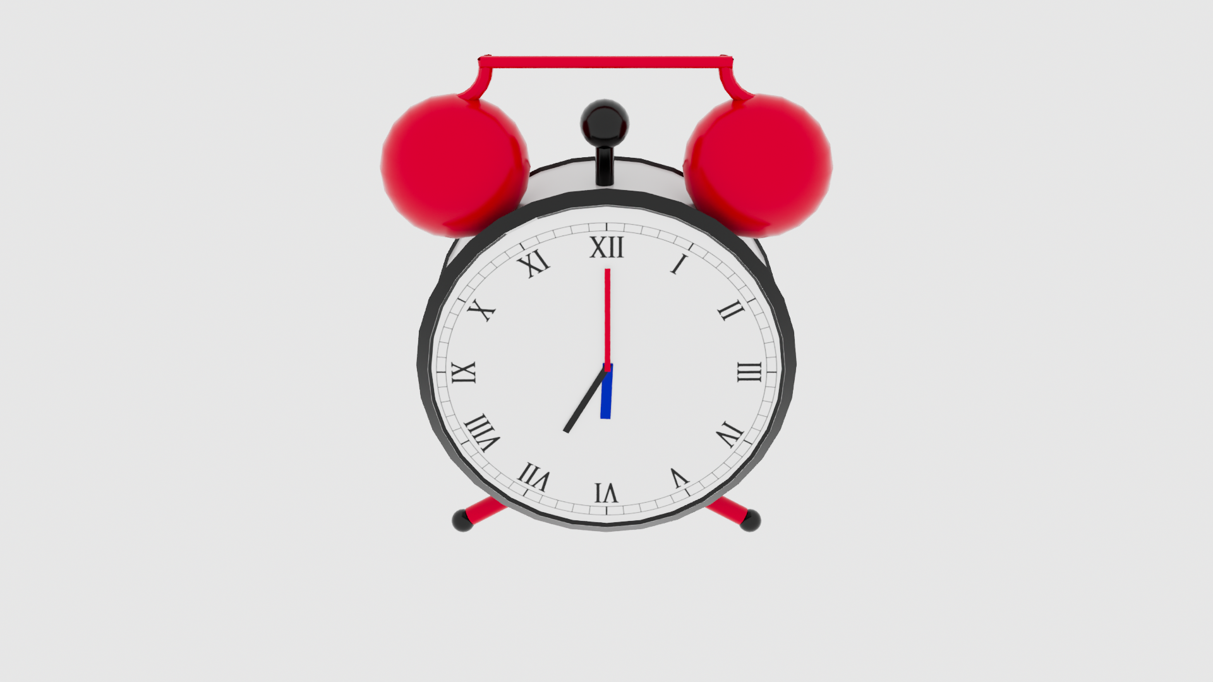
Goal: Model, texture, light, animate and render a 3D analog clock in Maya 2026
Clock animation done manually with keyframes
Tools: Maya 2026, Arnold, FFmpeg

Slide 3
Objective
Demonstrate 3D pipeline
Use transformations
Manual animation
Studio lighting
Arnold rendering

Slide 4
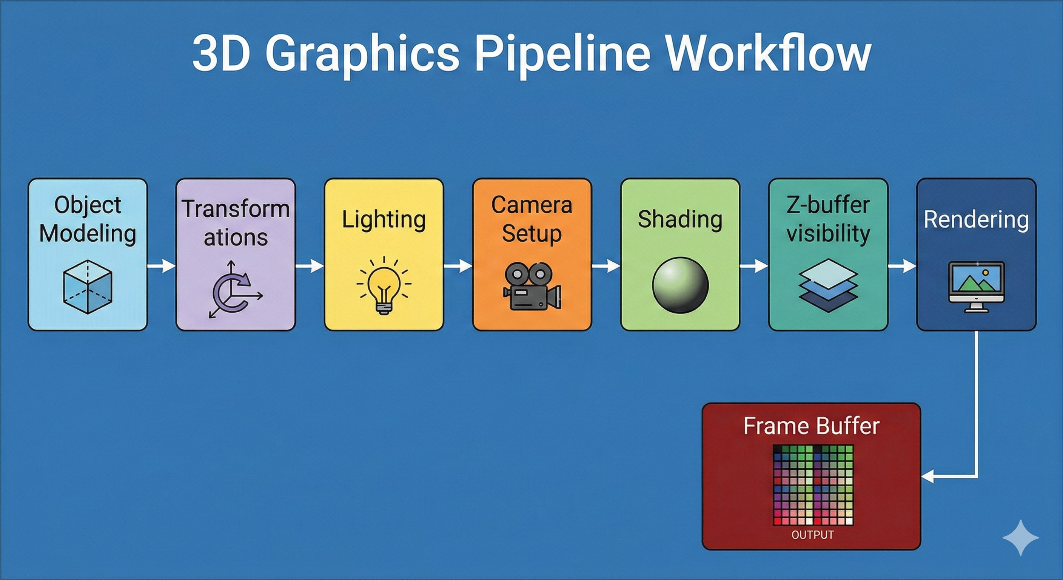
3D Viewing Pipeline
Object Modelling
Transformations
Shading
Lightning
Camera Setup
Z-buffer visibility
Rendering
Frame Buffer

Slide 5
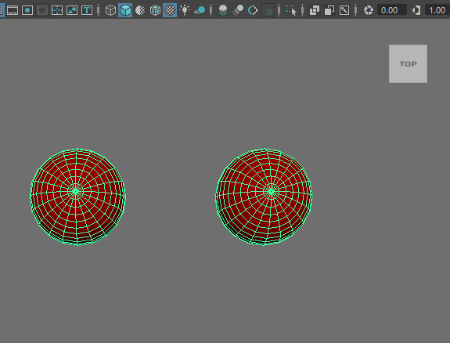
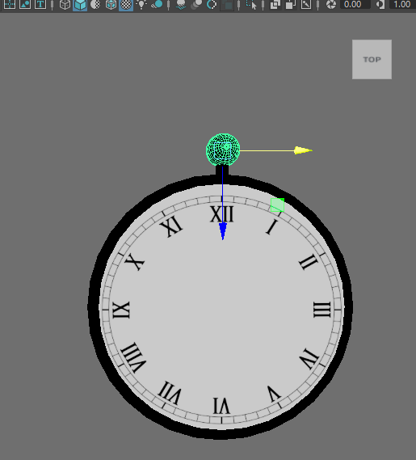
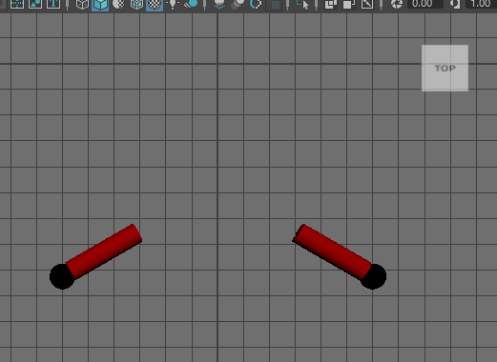
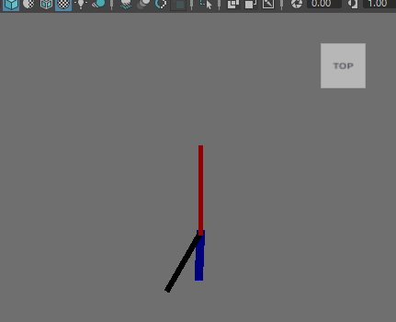
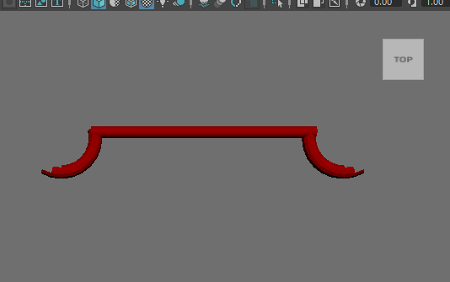
Modelling: Modelled using polygon primitives, extrusion, bevels and pivot placement
Bells
Main Body
Legs
Clock hands
Handle

Slide 6
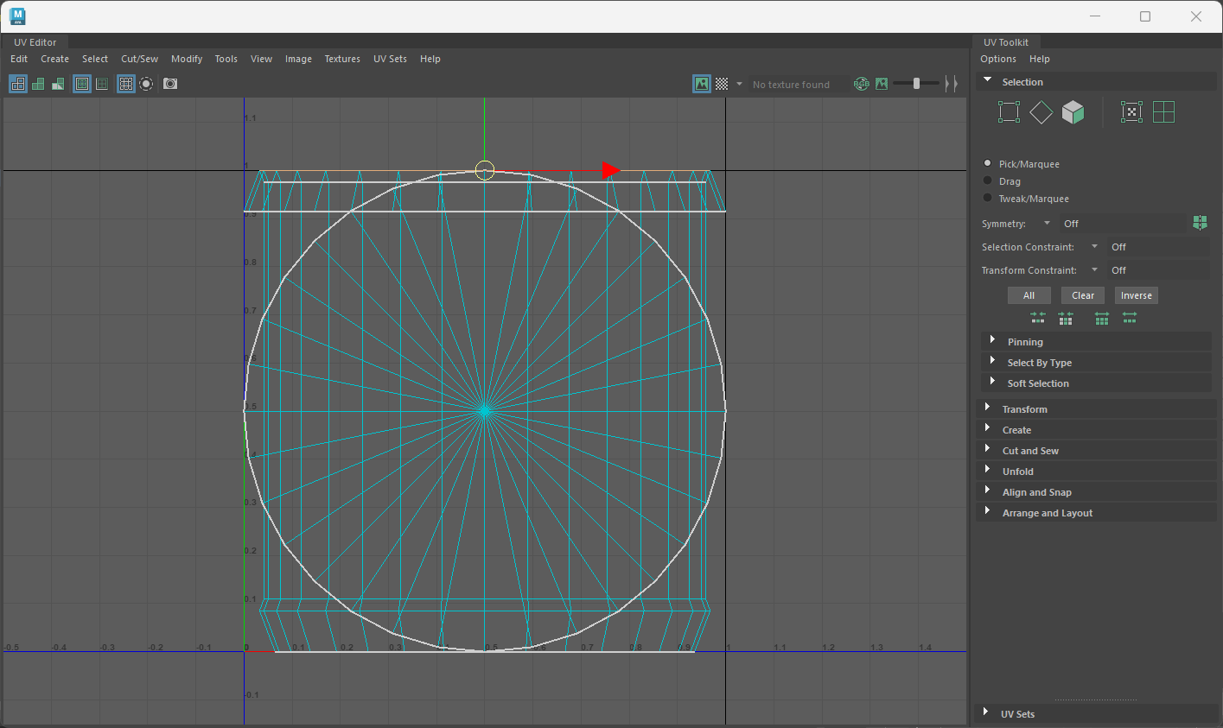
UV Mapping
Planar + automatic UVs
2K clock face texture applied
Screenshot of the face of clock getting UV mapped to apply clock texture

Slide 7
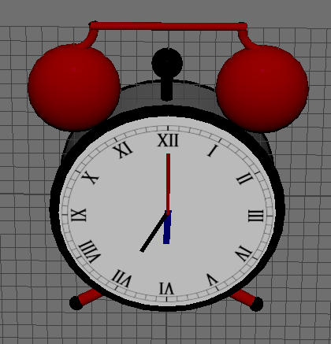
Shading
aiStandardSurface:
Enamel Body
Metal Bells
Dial
Legs
Handle

Slide 8
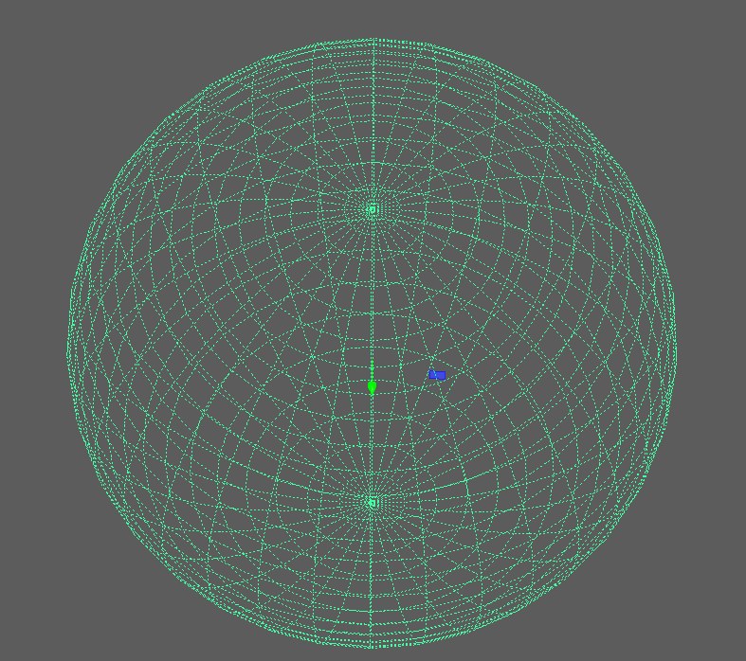
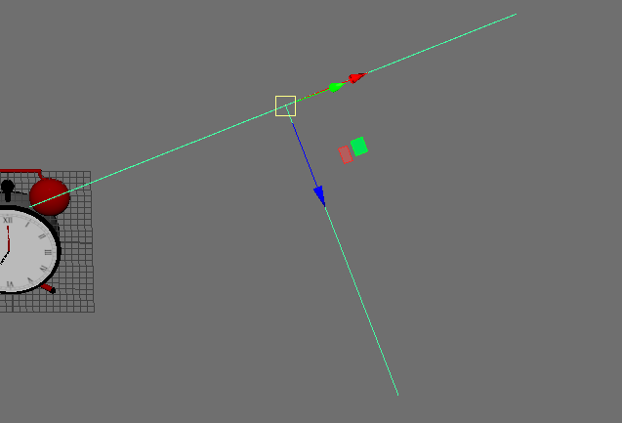
Lighting
Skydome
Area lights
HDRI lighting + key and rim area lights for soft shadows

Slide 9
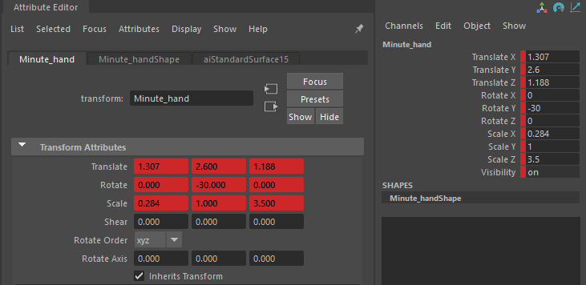
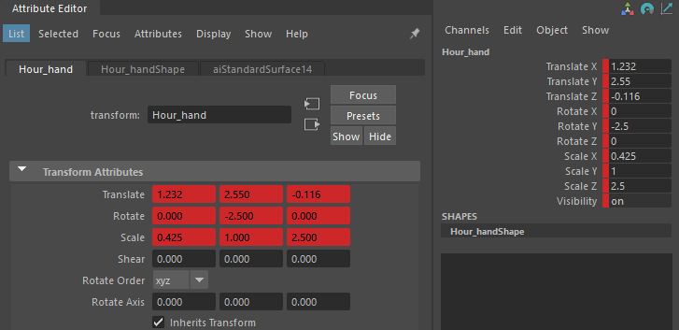
Manual Animation
Clock hands animated manually using keyframed rotation
24 FPS, correct pivots

Slide 10
Rendering & Video Creation
Arnold: 1920x1080
AA 4-5
OptiX denoiser
PNG sequence
360 rendered images were created
Merged into video using Ffmpeg command
Command: ffmpeg -framerate 24 -i "CLOCK_1.%04d.png" -pix_fmt yuv420p -crf 18 clock_animation.mp4

Slide 11
Challenges & Scope for Improvement
Challenges
Pivot alignment
Noise in shadows
UV cleanup
Glass transparency issues
Scope for Improvement
Add DOF
Add metal imperfections
More colour variants
Advanced ticking animation

Slide 12
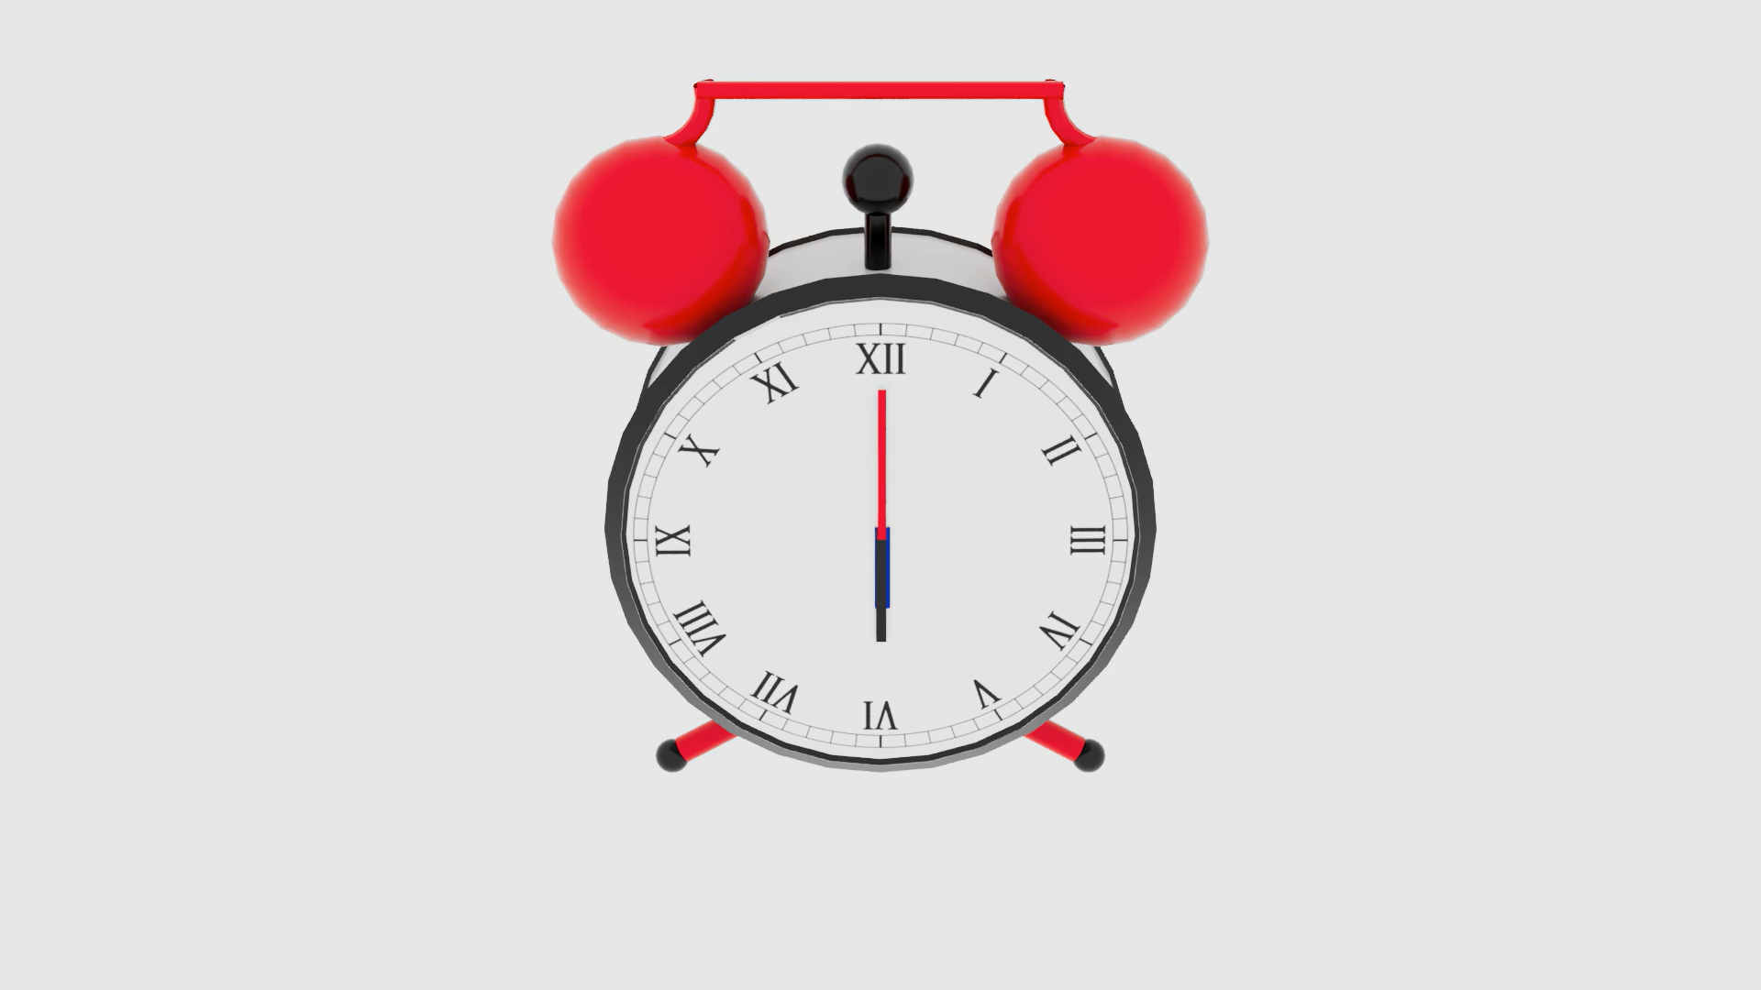
Result & References
Modelling Tutorials

